Slide 1
Using Machine Learning to predict Ontario Housing Price Ranges
By: Alec De Sousa and Hermes Hui

Slide 2
Problem Statement
The Ontario Housing market is highly diverse (urban condos to rural estates)
Traditional models (pricing regression) struggle with complexity
Focus on structural property characteristics rather than price
Dataset contains ~29,000 listings, 29 attributes (Remax, Feb 2025)
Multi-stage methodology:
K-means clustering (market segmentation)
Association rule mining (interpret cluster logic)
Random Forest (final classification)
Goal: transparent, interpretable classification system for properties

Slide 3
Dataset
Converted square footage from string → numeric
Created new feature: price per square foot
Major missing data issue:
Reduced dataset from ~29,000 → 2,261 (with sqft)
Created two datasets:
Small dataset: includes square footage (2,261 rows)
Large dataset: price, bedrooms, bathrooms (~26,890 rows)
Removed extreme outliers:
$22M property (vs $10M next highest)
68-bedroom property (vs 38 next highest)
Applied feature scaling (0–1 range) for clustering
Categorical prep for association rules:
Binned numeric features (low / med / high)
Cleaned and grouped localities (top 10 + “Other”)
Final dataset encoded for modeling

Slide 4
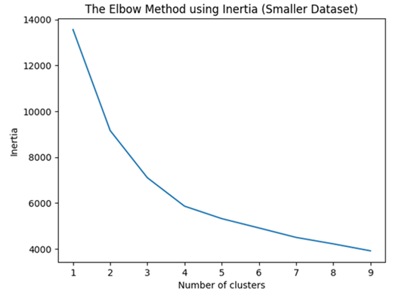
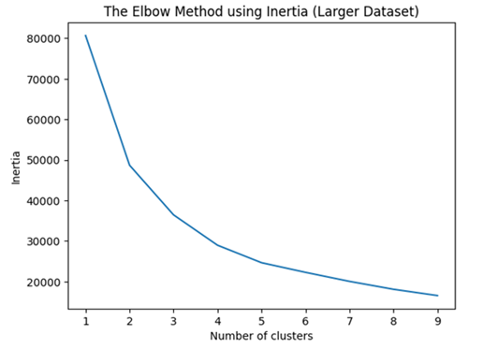
K-Means Clustering
Groups data points based on similarity
Chosen k = 3, which results in 3 clusters
Two versions of the dataset were prepared, one smaller (2,261 instances) and one larger (26,890 instances)

Slide 5
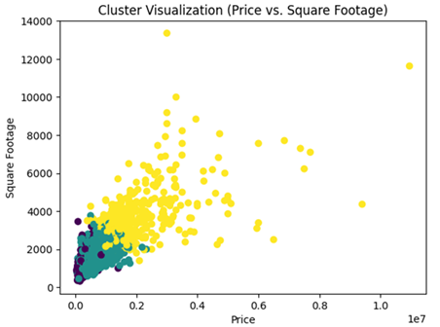
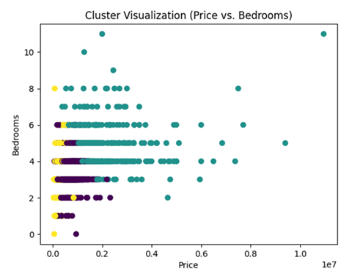
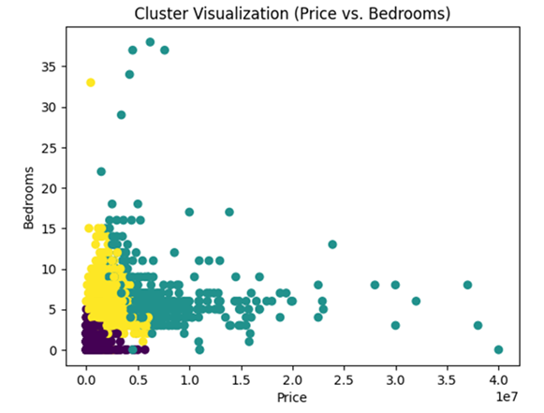
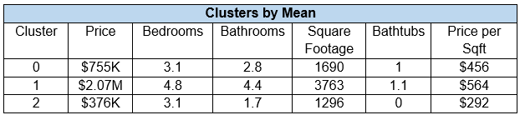
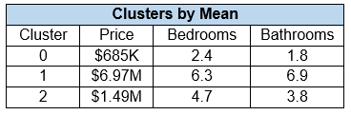
K-Means Clustering Results
Smaller Dataset:
Larger Dataset:

Slide 6
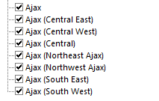
Association Rules
Helps find relationships between variables
Grouped localities together to avoid many options with sparse data
Counted only the top 10 localities, and grouped the rest under “Other”
“Ajax”

Slide 7
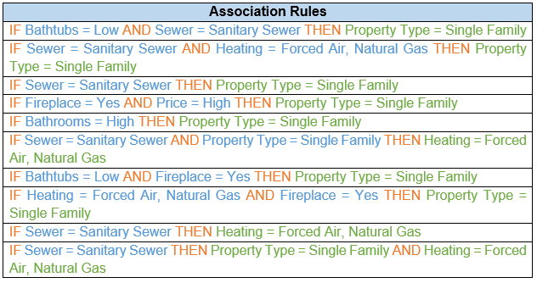
Association Rules Results
Rules were sorted by confidence
From the rules, it was found that residential characteristics strongly disgtinguish single family homes

Slide 8
Random Forest Model Configuration
Removed rows with missing cluster labels
Selected physical property features only (excluded admin data)
Applied one-hot encoding (drop_first = True)
Ensured target clusters treated as categorical (integers)
Used stratified train-test split (85/15)
Maintains proportional cluster representation
class_weight = balanced → handles class imbalance
min_samples_leaf = 5 → decreases overfitting
n_estimators = 200 → improves stability & reduces variance

Slide 9
Random Forest
Random Forest Confusion Matrix
 | Cluster 0 | Cluster 1 | Cluster 2
Cluster 0 | 106 | 54 | 34
Cluster 1 | 7 | 45 | 10
Cluster 2 | 4 | 4 | 75
Random Forest Accuracy |  |  | 0.6666666666666666
Random Forest Classification Report
 | precision | recall | f1-score | support
0 | 0.91 | 0.55 | 0.68 | 194
1 | 0.44 | 0.73 | 0.55 | 62
2 | 0.63 | 0.90 | 0.74 | 83
accuracy |  |  | 0.67 | 339
Macro avg | 0.66 | 0.73 | 0.66 | 339
Weighted avg | 0.75 | 0.67 | 0.67 | 339

Slide 10
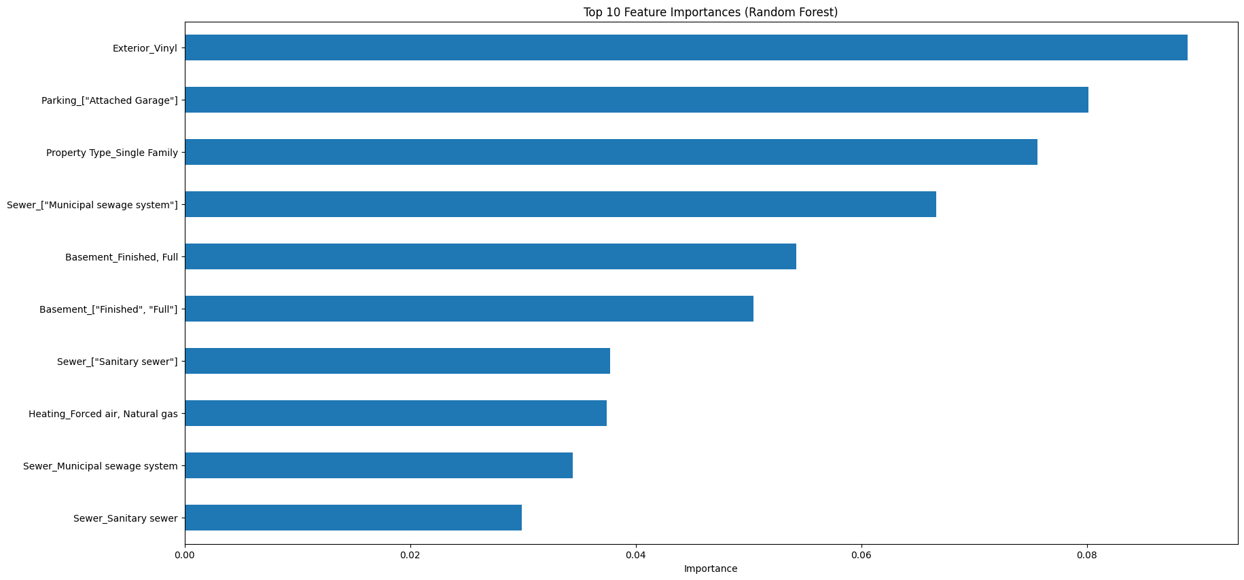
Random Forest

Slide 11
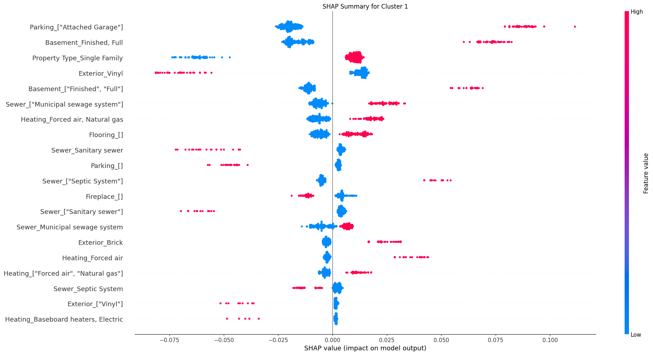
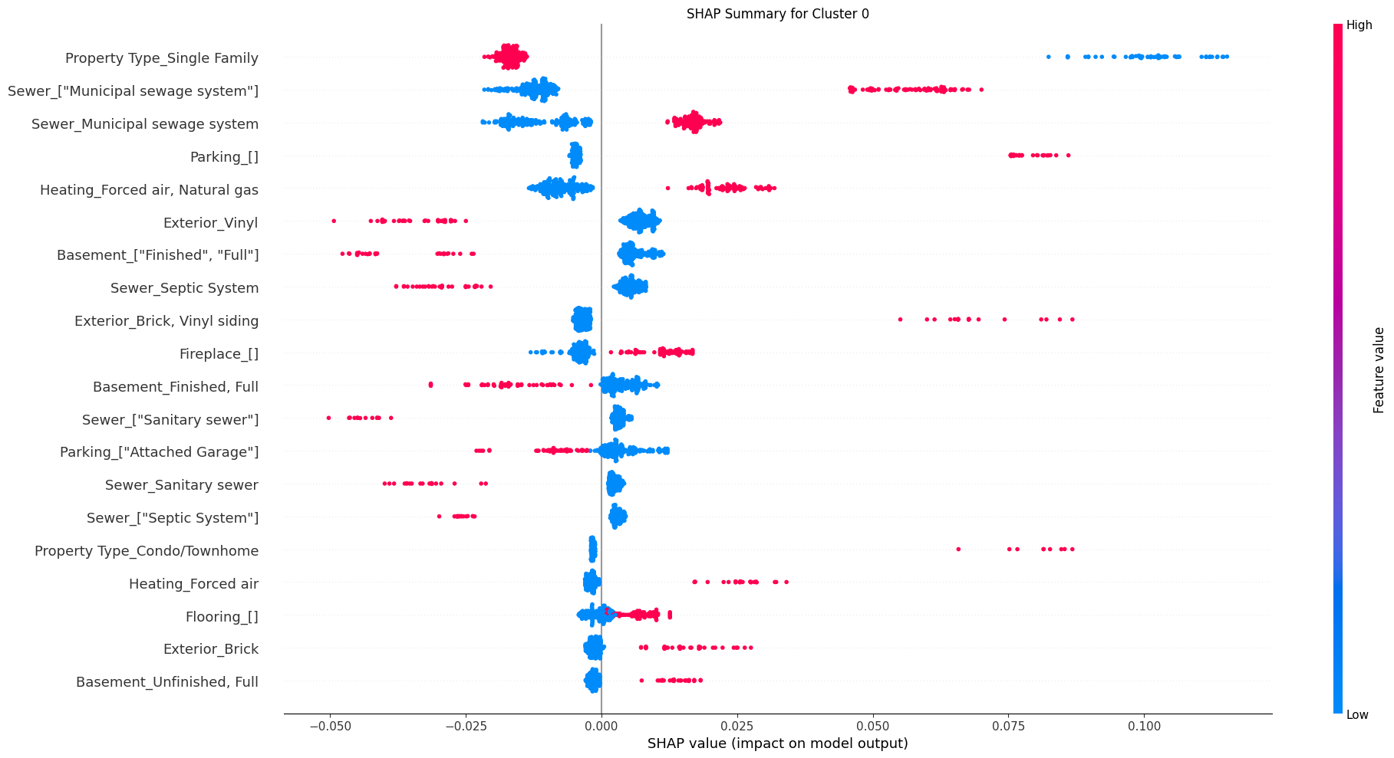
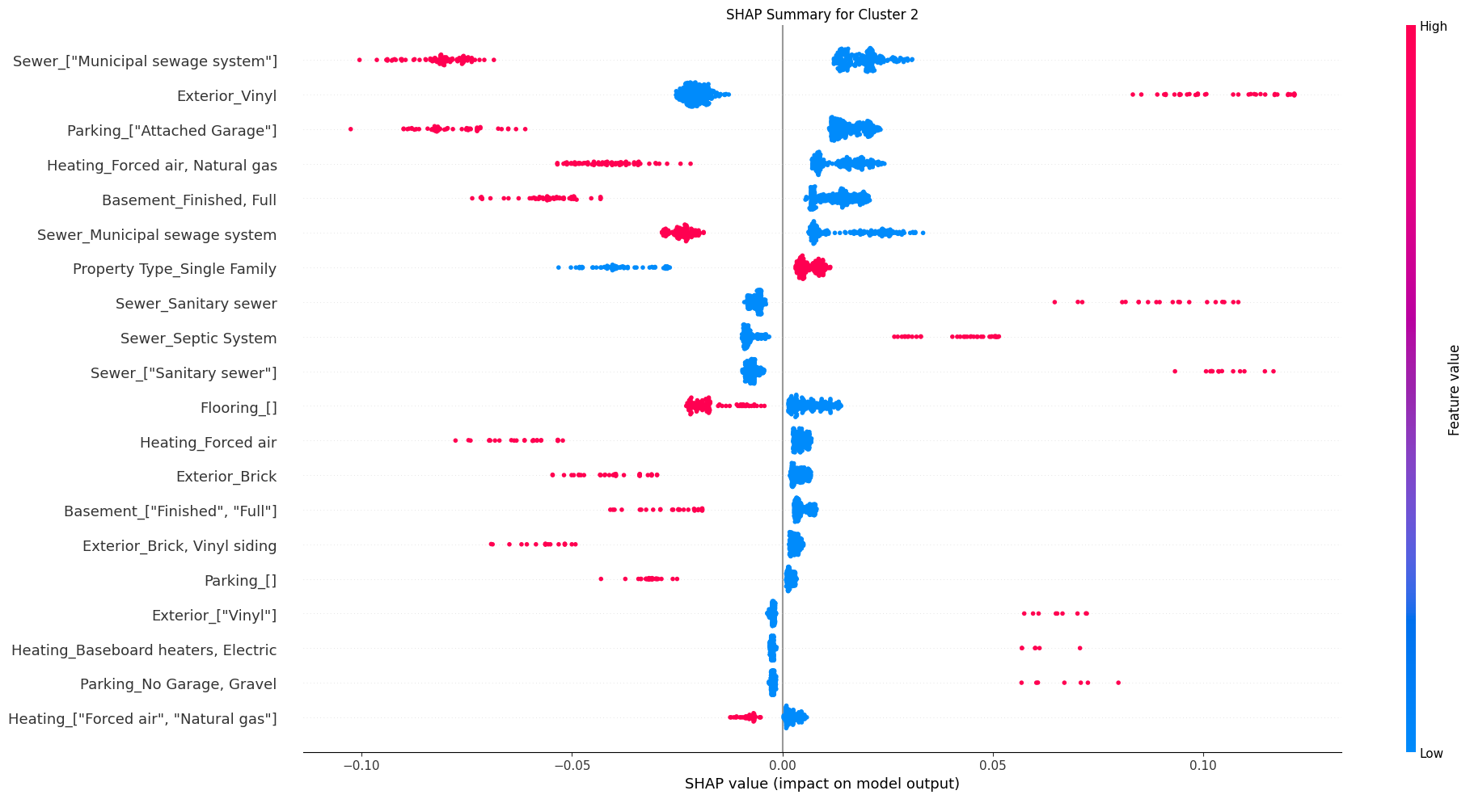
Random Forest SHAP

Slide 12
Overall Results
K-means clustering revealed clear housing market segments:
Lower, middle, and upper-class groupings across both datasets
Square footage strongly correlated with price (small dataset)
Bedroom count showed weak correlation with price
Association rules highlighted strong feature relationships:
Municipal sewer systems strongly linked to single-family homes
Features like fireplaces, forced air heating, and more bathrooms reinforce typical residential property patterns
Random Forest model performance:
Strong performance on lower-class (Cluster 2) listings
Struggled with middle-class (Cluster 0) → often misclassified
Upper-class cluster (Cluster 1) used as a “catch-all” in uncertain cases

Slide 13
Conclusion
Property classification is driven more by structural and infrastructural features than simple metrics like price or bedroom count
Most important predictive features:
Exterior material (vinyl)
Attached garage
Single-family property type

Slide 14
Thanks for watching!

